Slide 1
Coursera Capstone IBM Applied Data Science Capstone Exploring a place where opening a Shopping Complex would be more beneficial in Delhi NCR, India
Ajitesh Kohli
May 2, 2020

Slide 2
Delhi NCR (National Capital Region) in India comprises of holds true as the cultural hub for the youth central location.
It has a lot of companies and businesses so a lot of youth from all over the country
Business Problem and Targeted Audience
A businessman might want to know where it would be best suitable for opening a shopping mall in Delhi NCR on the basis of the places where the audience footfall is the maximum.
Large audience footfall means many brands would like to invest in that area to attract more customers.

Slide 3
Data Acquisition and Cleaning
The data for the analysis was being accumulated by using Foursquare API.
From Foursquare, the details of the venues: name, type of venue, geographical location , city were fetched.
The complete data was not available for the free Foursquare account.
The total data comprised of 178 venues.

Slide 4
Data Analysis
According to the analysis of the available data, it was found that maximum venues are Restaurants, followed by Hotel, then Cafés and then shopping malls, followed by others as shown in the bar graph below.
Out of the total 8 big shopping malls available in the data, 4 are in Delhi and 4 are in Gurgaon.

Slide 5
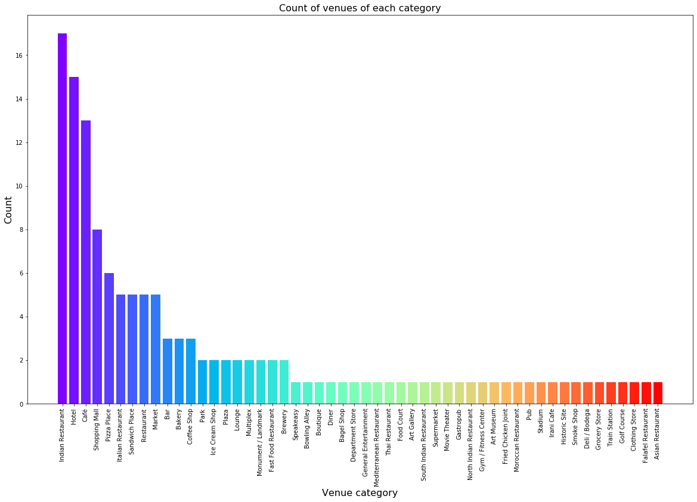

Slide 6
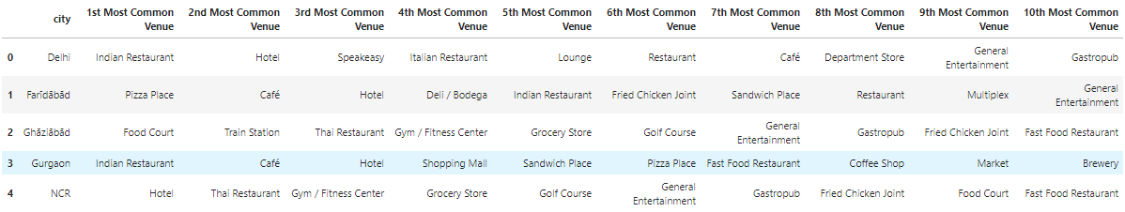
The data was further processed and finally sorted in descending order on the basis of the occurrence in that region as shown below in the diagram.

Slide 7
Data Clustering
The data was clustered to depict similar regions using K means clustering based on the available information of each venue. This will allow us to clearly identify which places have the largest number of venues and will be suitable for opening a shopping mall.
The data was organized in 5 clusters

Slide 8
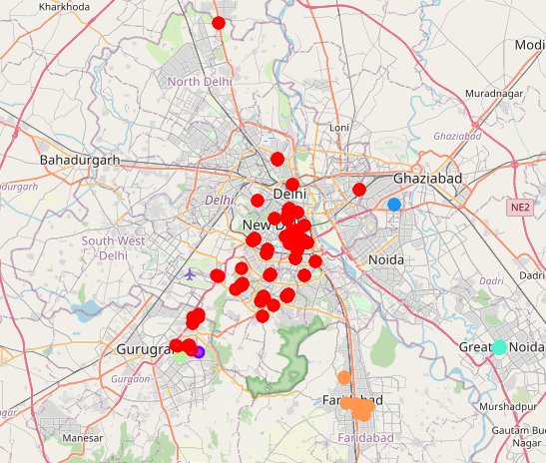
Result and Discussions
Upon clustering , we got the different clusters.
Based on the data available, Delhi region has the most similar cluster with maximum number of venues, followed by Gurgaon, Faridabad and Greater Noida.

Slide 9
Conclusion and Future Direction
So for a business establishment according to the data in hand, it would be advisable to open a new mall in either Delhi region or Gurgaon region.
If a more elaborative data is available, then it can be fed back to the model and results can further be improved.

